Slide 1


Naol Teshome
12/23/2023

Slide 2
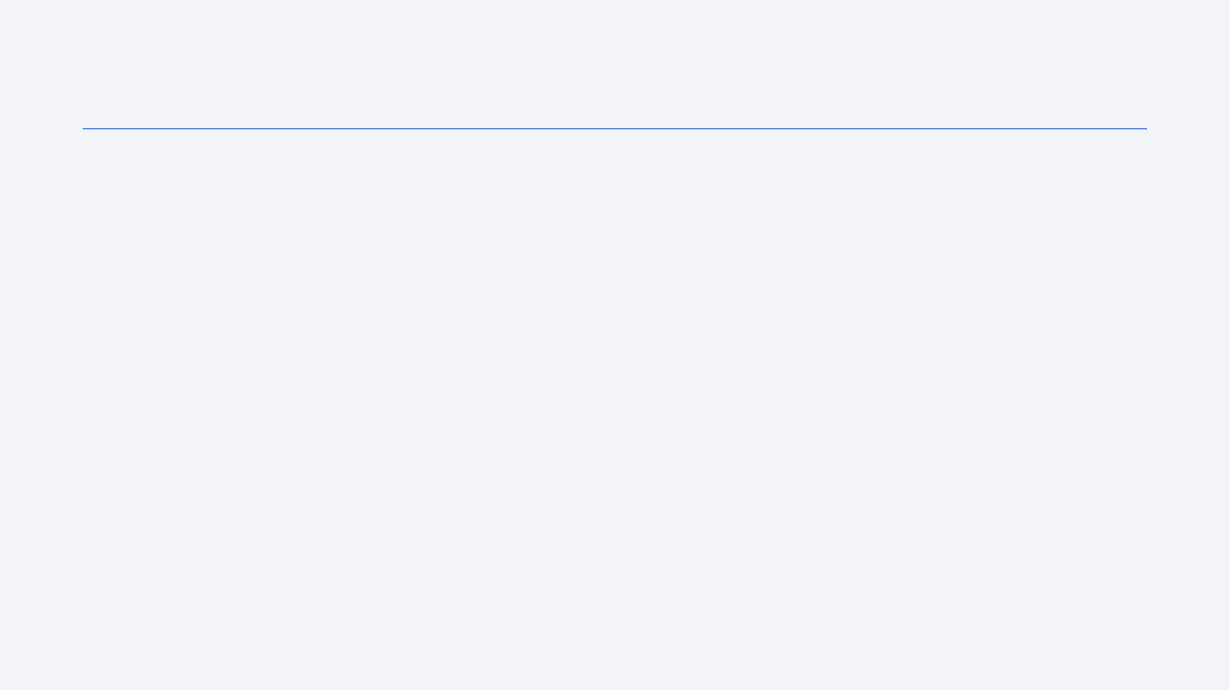
Outline
Executive Summary
Introduction
Methodology
Results
Conclusion
Appendix

Slide 3
Executive Summary
In a market where there is very little amount of competition space X has revolutionized space exploration with their reusable rockets
Falcon9 booster successful recovery depends on features such as:
orbit
payload mass
booster versions
Launching sites
Many different machine learning algorithms are used to predict the likely hood of Falcon9 booster recovery.
Based on these features, the best Machine Learning supervised classification model developed in this report, predicted booster recovery outcome with an accuracy close to 94%.

Slide 4
Introduction
In the 1970s and 1980s, non-military commercial satellites began to be launched in large numbers.
From 2000 to 2017, Ariane 5 (ESA - Arianespace) dominated the market with: lower cost, high payload mass, reliability.
In terms of cost, China, India, Russia are tough competitors with less reliable classic launchers like LongMarch, Proton, Soyuz-2, PSLV. New players like BlueHorizon are still in early stage.
Since 2017, SpaceX Falcon9/Falcon9 Heavt is increasingly dominating the market with better cost per kg thanks to the reusable booster concept.
Competition may heat up again with the advent of Ariane 6 and SpaceX Starship.

Slide 5
Introduction
Falcon 9/Falcon9 heavy v. Ariane 6
Falcon9 / Falcon 9 Heavy can easily compete with new Ariane 6 (2 or 4 boosters) in terms of:
Cost per kg
Payload mass
SpaceX Starship will further crush the competition in both domains.
Falcon9 and Starship costs are way lower due to reuse of boosters
Ariane-6 will be a classic launcher for reliability purposes
Falcon9 reliability can’t compete with Ariane-5G record
Falcon9 booster recovery success rate is still an issue.

Slide 6
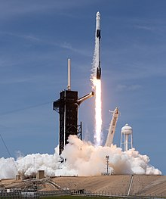
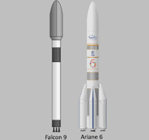
Introduction

Slide 7

Section 1

Slide 8
Methodology
Executive Summary
1. Data collection from open Data base and Wikipedia (Falcon9, Ariane-5).
2. Data wrangling.
3. Exploratory data analysis using SQL query and visualization of correlation between parameters.
4. Visual analytics: launch sites with Folium, success rates with Plotly Dash.
5. Classification Models development and validations. Selection of best predictive model

Slide 9
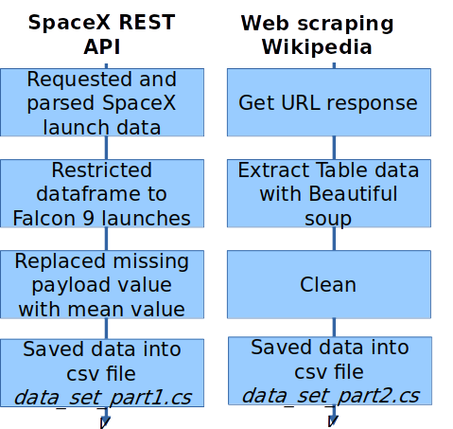
Data Collection
Data was collected from:
open source SpaceX REST API
webscraping Falcon9 launch data in
Wikipedia

Slide 10
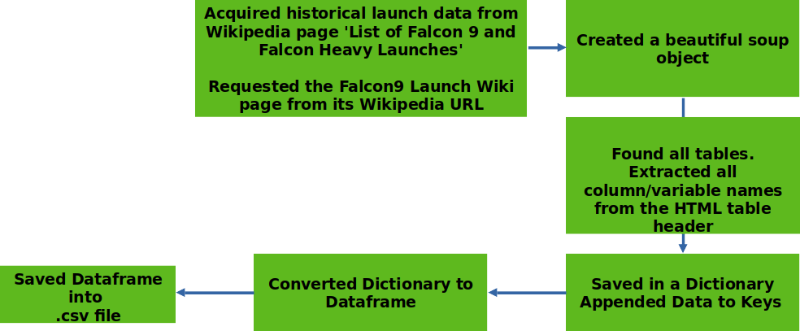
Data Collection – SpaceX API
https://github.com/Nana8182/Falcon9-success-rate-analysis-project/blob/main/Data%20Collection/data%20collection%20using%20api.ipynb

Slide 11
Data Collection - Scraping
Preliminary Stage
We defined a series of functions helping the use the API to extract information
getBoosterVersion(data)
getLaunchSite(data)
getPayloadData(data)
getCoreData(data)

Slide 12
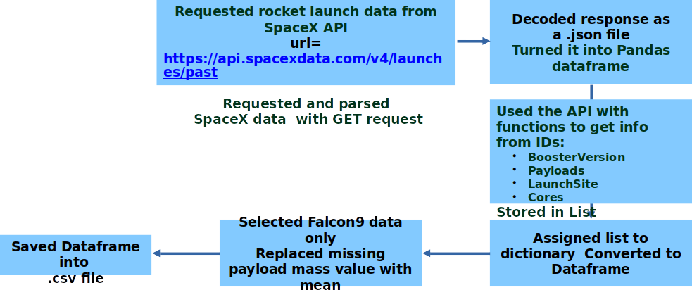
Data Collection - Scraping
https://github.com/Nana8182/Falcon9-success-rate-analysis-project/blob/main/Data%20Collection/webscraping.ipynb

Slide 13
Data Wrangling
Replace missing values with mean
Identifies NULL values
Created a training label class
Identified missing values
https://github.com/Nana8182/Falcon9-success-rate-analysis-project/blob/main/Data%20wrangling.ipynb

Slide 14
EDA with Data Visualization
Scatter Plots
Flight Number VS. Payload Mass
Flight Number VS. Launch Site
Payload VS. Launch Site
Orbit VS. Flight Number
Payload VS. Orbit Type
Orbit VS. Payload
Bar Graphs
Mean VS. Orbit
Line Graphs
Success Rate VS. Year
https://github.com/Nana8182/Falcon9-success-rate-analysis-project/blob/main/Explanatory%20Data%20Analysis/eda%20data%20visualization.ipynb

Slide 15

EDA with SQL
Performed SQL queries to gather information about the dataset. Some of the questions we were asked about the data is
Displaying the names of the unique launch sites in the space mission
Displaying 5 records where launch sites begin with the string 'CCA’
Displaying the total payload mass carried by boosters launched by NASA (CRS)
Displaying average payload mass carried by booster version F9 v1.1
Listing the date where the successful landing outcome in drone ship was achieved.
Listing the names of the boosters which have success in ground pad and have payload mass greater than 4000 but less than 6000
Listing the total number of successful and failure mission outcomes
Listing the names of the booster versions which have carried the maximum payload mass.
Listing the records which will display the month names, successful landing outcomes in ground pad ,booster versions, launch site for the months in year 2017
Ranking the count of successful landing outcomes between the date 2010-06-04 and 2023-03-20 in descending order.
https://github.com/Nana8182/Falcon9-success-rate-analysis-project/blob/main/Explanatory%20Data%20Analysis/eda%20sql%20sqllite.ipynb

Slide 16
Build an Interactive Map with Folium
Launch success rate may depend on the location and proximity of a launch site.
Folium Interactive Map was used for visualizing and analyzing SpaceX Launch Sites.
Used Interactive mapping library called Folium , Identified all SpaceX launch sites on a map: Florida, California , Included longitude and latitude info.
Identified successful/failed launches for each site on map Calculated the distance between a launch site (CCAFS_SLC40 in Cape Canaveral, FL ) and:
Closest coastline
Closest high traffic density railway:
Florida East Coast Railway
Closest high traffic density highway: Interstate I95
Closest high density urban area: Orlando (FL)
https://github.com/Nana8182/Falcon9-success-rate-analysis-project/blob/main/Interactive%20visual%20Analysis%20and%20Dashboard/launch%20%20site%20location%20with%20Folium.ipynb

Slide 17

Build a Dashboard with Plotly Dash
We built an interactive dashboard with Plotly including:
Dropdown menu for selecting launch sites
Pie charts displaying success rate.
Scatter chart displaying launch site, payload mass, success/failure
Range slider for selecting range of payload mass (kg).
For analyzing SpaceX launch records features:
site with largest successful launches.
site with highest launch success rate
payload range(s) with highest launch success rate
payload range(s) with lowest launch success rate
F9 Booster version (v1.0, v1.1, FT, B4, B5, etc.) with highest launch success rate.
https://github.com/Nana8182/Falcon9-success-rate-analysis-project/blob/main/Interactive%20visual%20Analysis%20and%20Dashboard/spacex_dash_app.py

Slide 18
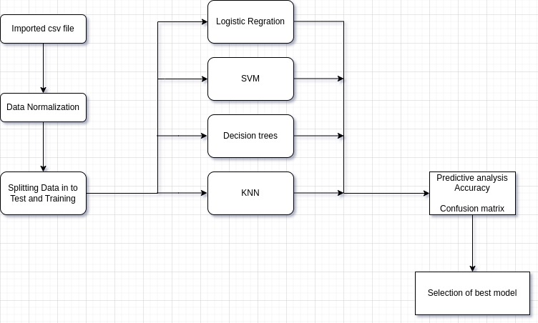
Predictive Analysis (Classification)
https://github.com/Nana8182/Falcon9-success-rate-analysis-project/blob/main/Machine%20Learning%20Prediction.ipynb

Slide 19

Section 2

Slide 20
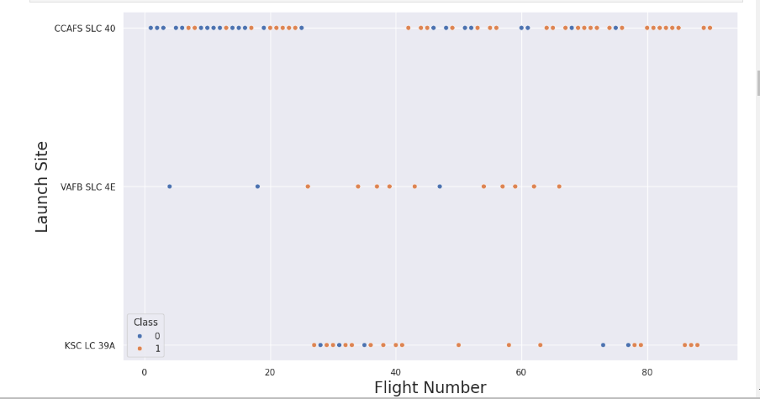
Flight Number vs. Launch Site
CCAFS-SLC 40 is the most used launch site.
CCAFS-SLC 40 has most of failures , particularly in the early stage of Falcon9 project

Slide 21
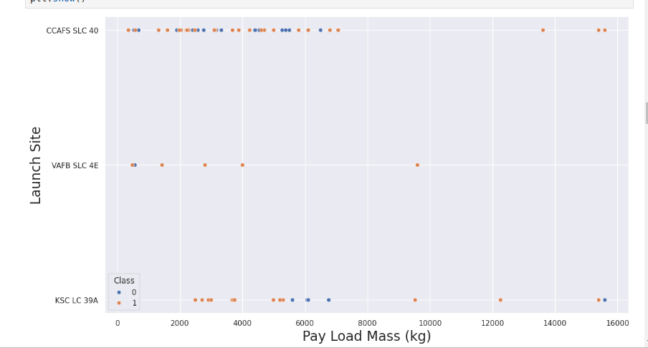
Payload vs. Launch Site
Given Falcon9 specifications, heavy payloads are sent to low/medium orbits
It looks like the percentage of failures is lower for heavy payload.
More information is needed for extracting some correlation: success rate v. payload/orbit

Slide 22
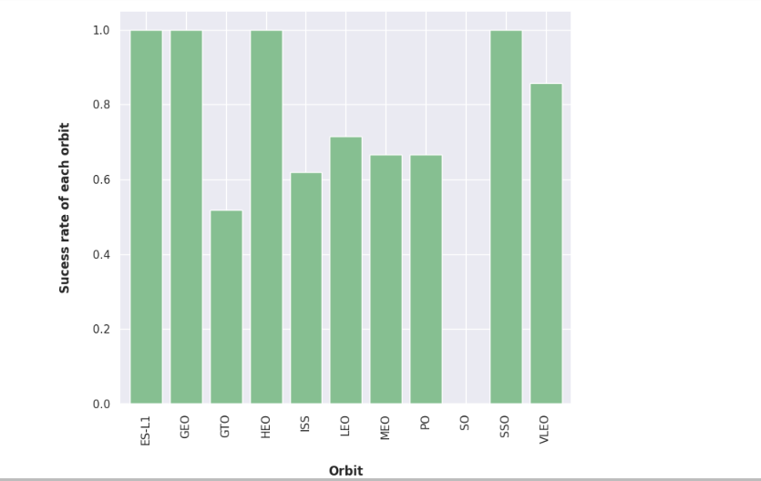
Success Rate vs. Orbit Type
GTO sees the lowest success rate.
SSO (polar low orbit) the highest one.
Success rate may strongly depend on both: payload mass and orbit.

Slide 23
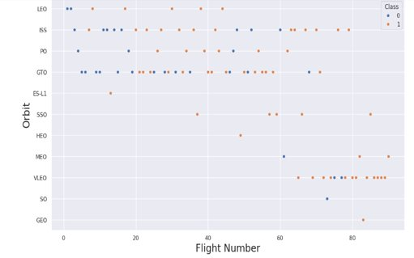
Flight Number vs. Orbit Type
The number of flights for: GEO, SO, HEO, ESL-1, MEO is not significant for concluding about success rate.
It looks like GTO are higher risk missions, low orbits are lower risk.

Slide 24
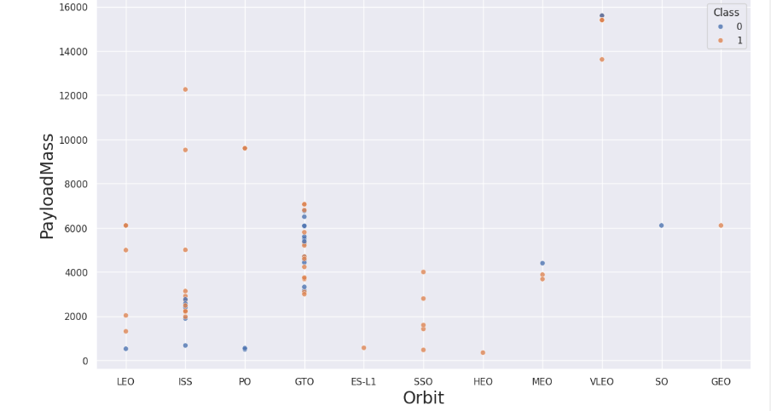
Payload vs. Orbit Type
Maximum success rate with: low orbit except (ISS) and low payload mass
Between 2000 and 7500 kg, success rate seems to be evenly distributed for GTO.
Independently of payload mass, GTO is a risky “orbit” affecting missions success rate. Falcon 9 reliability improves over time, but there are still recent failed booster recovery after GTO launches

Slide 25
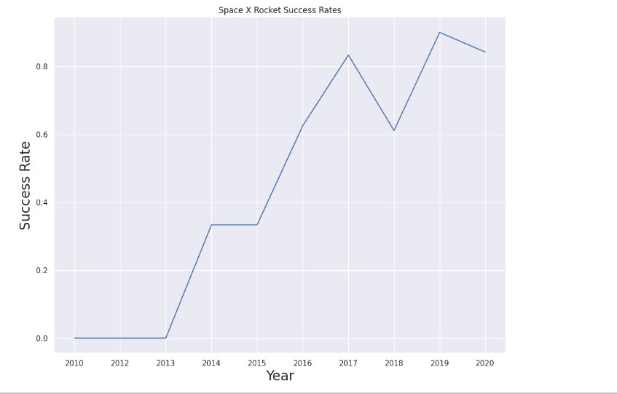
Launch Success Yearly Trend
Falcon 9 reliability significantly improves over time .
Falcon9 average booster recovery success rate si 66%.
Success rate currently sufficient for SpaceX financial viability.

Slide 26
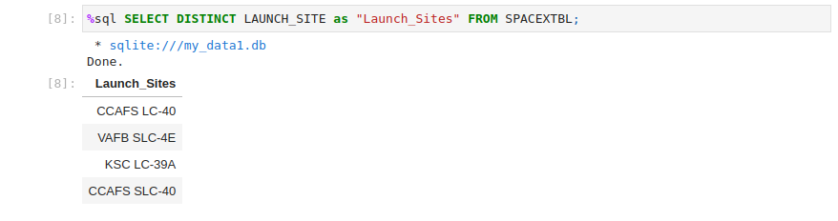
All Launch Site Names

Slide 27
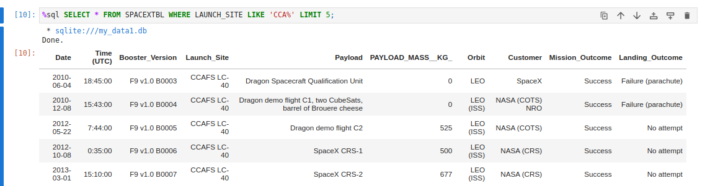
Launch Site Names Begin with 'CCA'

Slide 28
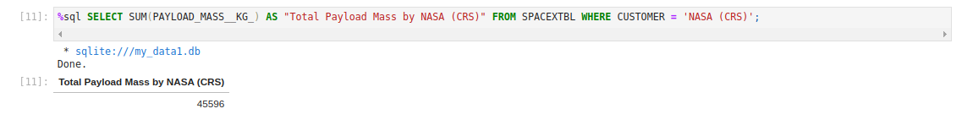
Total Payload Mass

Slide 29
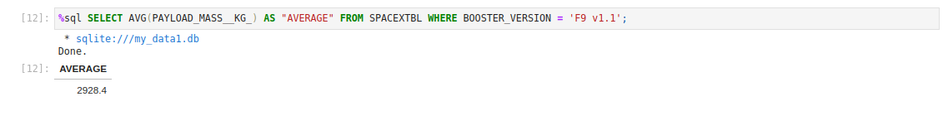
Average Payload Mass by F9 v1.1

Slide 30
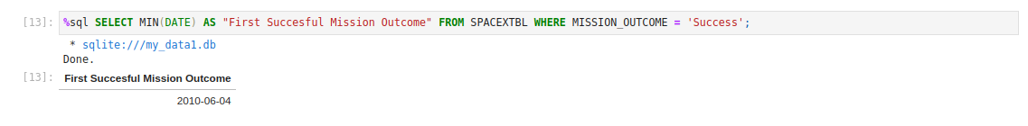
First Successful Ground Landing Date

Slide 31
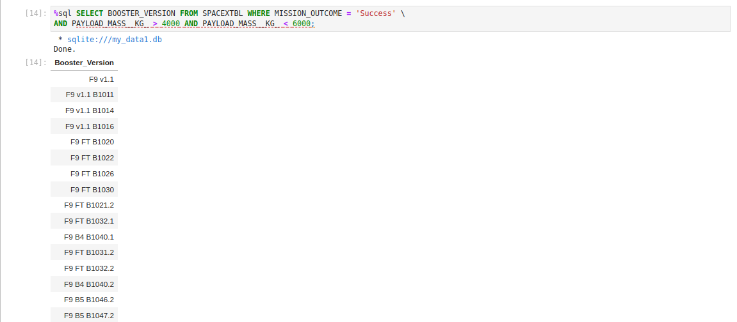
Successful Drone Ship Landing with Payload between 4000 and 6000

Slide 32
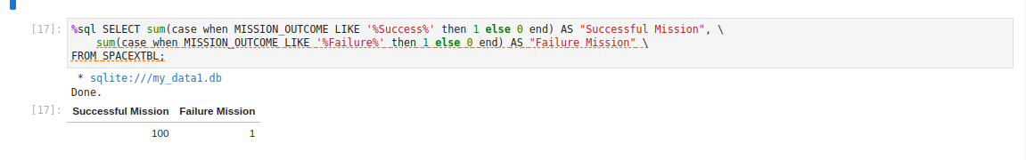
Total Number of Successful and Failure Mission Outcomes

Slide 33
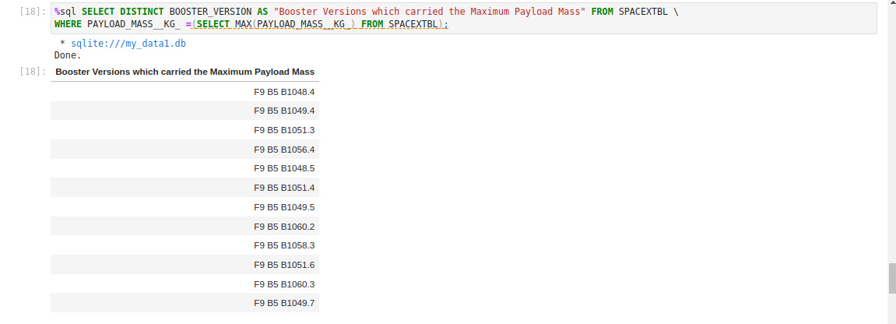
Boosters Carried Maximum Payload

Slide 34
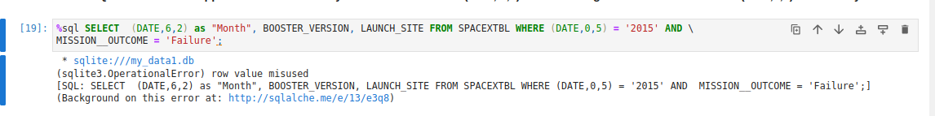
2015 Launch Records

Slide 35
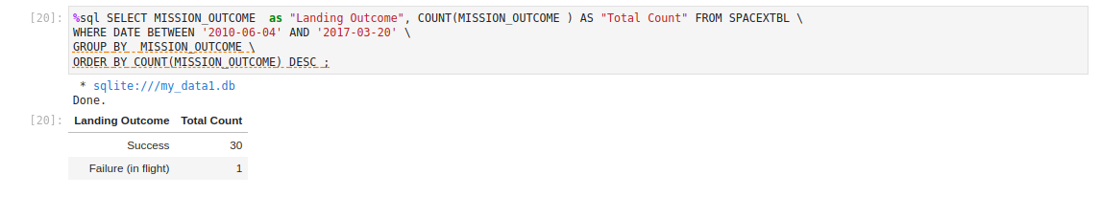
Rank Landing Outcomes Between 2010-06-04 and 2017-03-20

Slide 36

Section 3

Slide 37
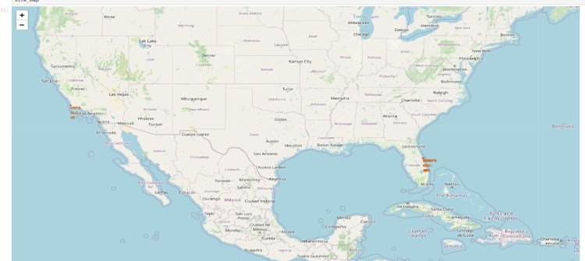
SpaceX: All launch sites

Slide 38
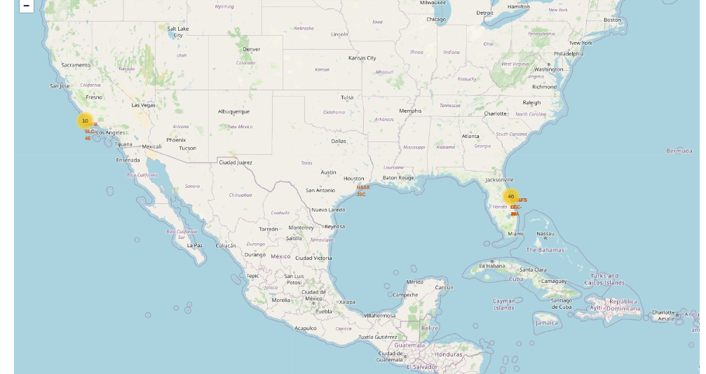
success/failed launches for each site on the map

Slide 39
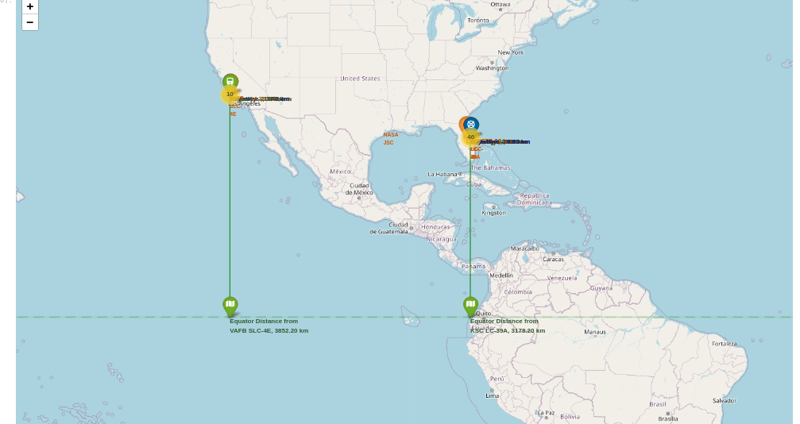
Distances between a launch site to its proximities

Slide 40

Section 4

Slide 41
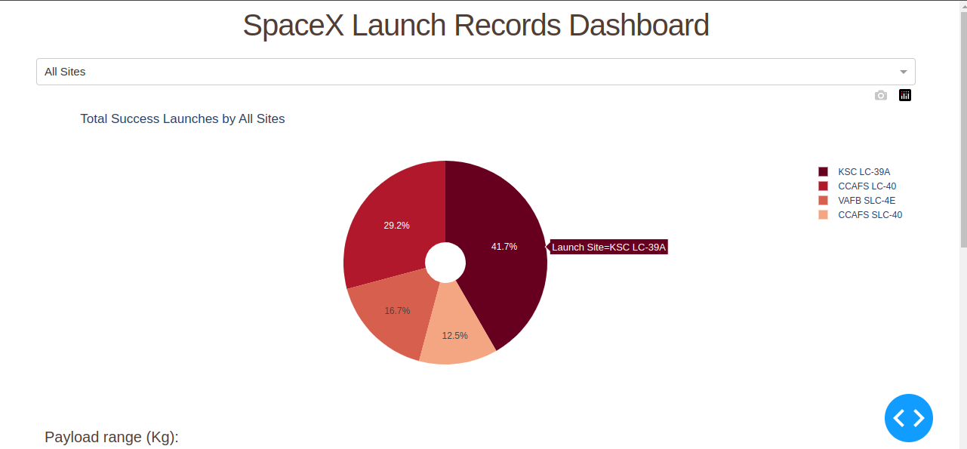
Total success launch by all sites

Slide 42
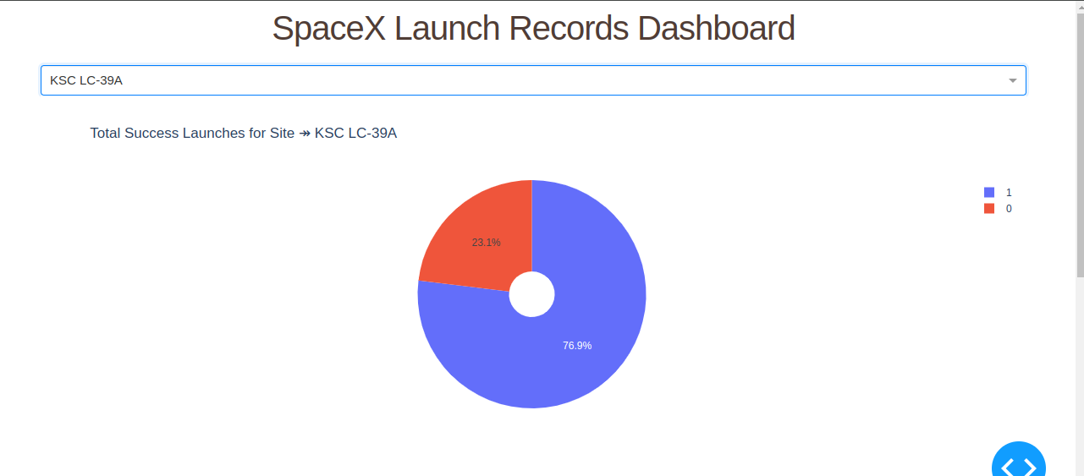
SpaceX Falcon9 Launch site with highest launch success ratio

Slide 43
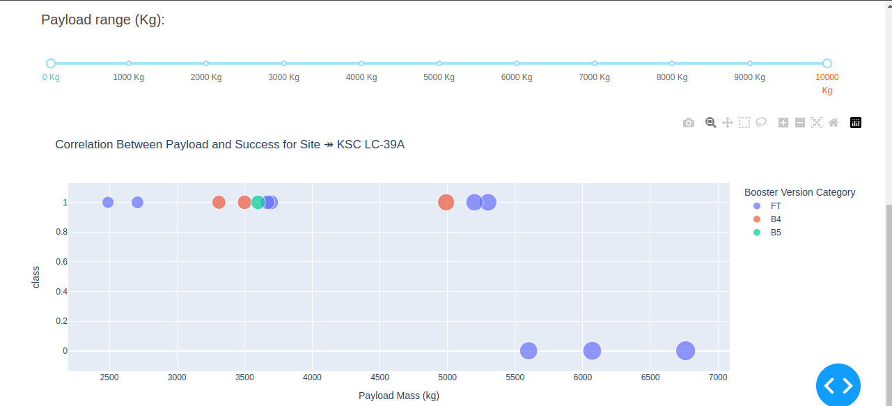
Launch outcome v. Payload mass

Slide 44

Section 5

Slide 45
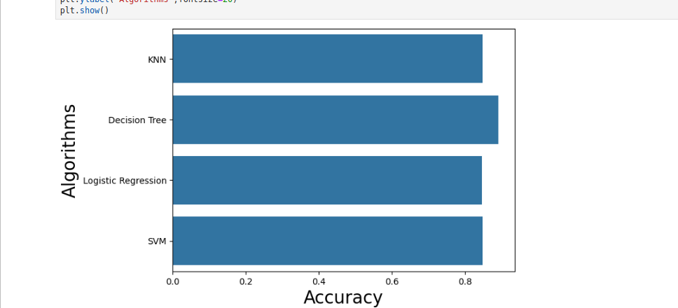
Classification Accuracy
45
As we can see Decision trees have the highest accuracy out of the four Algorithms used

Slide 46
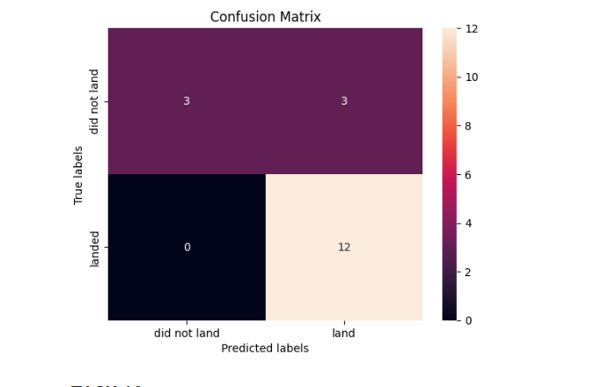
Confusion Matrix

Slide 47
Conclusions
We defined success as a successful recovery process of Falcon9 booster.
From Falcon 9 and Wiki we imported data and developed tools for investigating factors driving successful booster recovery: Payload, Orbit, Booster version, Launching sites…
Based on these features, we selected a supervised classification model capable of predicting launch outcome with a 94% accuracy. Falcon9 booster recovery process is more risky than a classic launcher, but its success rate: increases overtime and at 66%, it is sufficient for maintaining a competitive cost per kg compared with classic Ariane5 /Ariane 6.
SpaceX GEO/GTO flights are more risky.
Failure could be linked to energy deployed at lift-off, vibrations damaging of electronics, control systems of the booster.
ESA/ArianeEspace, Soyuz have an advantage in terms of launch site, on the equator: less energy is required for GTO/GEO flights.
SpaceX could improve GEO/GTO flights success with a concept like “Sea Launch” close to the equator. Recent successes with FT boosters landing on “drone ship”, bodes well for such a solution.
Even with recent recovery failure for GTO/GEO, SpaceX will maintain a sufficient lead in terms of cost per kg. vs Ariane5 and the new Ariane 6. Starship may well crush further the competition if similar success rate is achieved

Slide 48
References and Jupyter Notebooks
https://github.com/Nana8182/Falcon9-success-rate-analysis-project/tree/main
https://github.com/Nana8182/Falcon9-success-rate-analysis-project/blob/main/Data%20Collection/data%20collection%20using%20api.ipynb
https://github.com/Nana8182/Falcon9-success-rate-analysis-project/blob/main/Data%20Collection/webscraping.ipynb
https://github.com/Nana8182/Falcon9-success-rate-analysis-project/blob/main/Data%20wrangling.ipynb
https://github.com/Nana8182/Falcon9-success-rate-analysis-project/blob/main/Explanatory%20Data%20Analysis/eda%20data%20visualization.ipynb
https://github.com/Nana8182/Falcon9-success-rate-analysis-project/blob/main/Explanatory%20Data%20Analysis/eda%20sql%20sqllite.ipynb
https://github.com/Nana8182/Falcon9-success-rate-analysis-project/blob/main/Interactive%20visual%20Analysis%20and%20Dashboard/launch%20%20site%20location%20with%20Folium.ipynb
https://github.com/Nana8182/Falcon9-success-rate-analysis-project/blob/main/Interactive%20visual%20Analysis%20and%20Dashboard/spacex_dash_app.py
https://github.com/Nana8182/Falcon9-success-rate-analysis-project/blob/main/Machine%20Learning%20Prediction.ipynb

Slide 49


